Slide 1
Experimental Demonstration of Spatial Rogue Waves in the Passively Q-switched Nd:YAG Laser
R. Navitskaya^{1,2}, I. Stashkevich², S. Derevyanko¹, and A. Karabchevsky¹
1 School of Electrical and Computer Engineering, Ben-Gurion University of the Negev
2 Faculty of Physics, Belarusian State University, Nezavisimosti Avenue 4, 220030 Minsk, Belarus

Slide 2
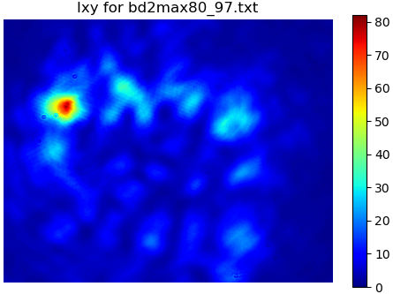
Introduction
Rogue waves (RWs) are isolated events with exceptional amplitude, that form spontaneously and disappear without a trace. RWs can be observed in different optical systems.
Spatial RWs, also known as ”hot spots”, represent tightly focused spots in the transverse cross-section of the beam that have peak intensities much higher than the average beam intensity.
RWs characteristics: $I_{RW}>4I_{SWH},$ where $I_{SWH}$ (significant wave height) is the average intensity of the highest one-third of the waves nearby; $PDF(I)$ has ‘L-shaped’ form.
It is suggested that the most probable mechanism of spatial RWs formation in lasers is nonlinear interaction of transverse modes*.
RW
Research motivation:
Investigate the statistics of spatial rogue waves and its dependence on the number of transverse modes that nonlinearly interact in the laser cavity and form the output beam patterns.
* C. Bonazzola et al., Extreme events and single-pulse spatial patterns observed in a self-pulsing all-solid-state laser, Phys. Rev. E 97, 032215, 2018

Slide 3
Passively Q-switched Nd:YAG Laser Setup
Nd:YAG laser is passively Q-switched with the use of a saturable absorber.
Different mode configurations are obtained by tuning the diaphragm size and the laser mirrors alignment.
The output beam spatial profile is recorded by a camera synchronized with the laser repetition rate (5 Hz) – it captures the transverse intensity distribution integrated over the duration of the Q-switch pulse.
Nd:YAG active element
Q-switch shutter
Output mirror
Filters and camera
100% mirror
Iris diaphragm
Scheme of the experimental setup.

Slide 4
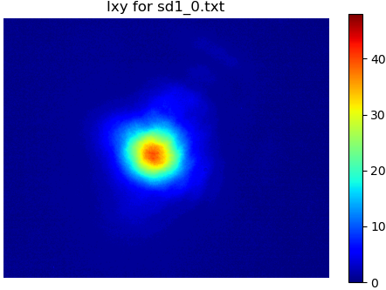
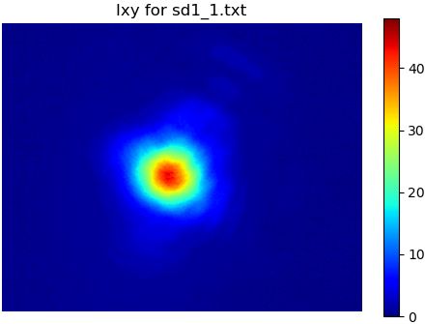
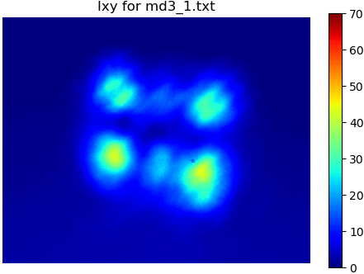
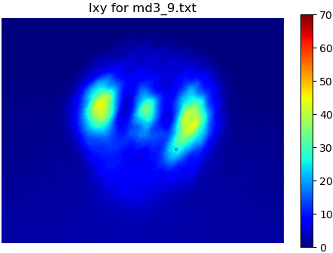
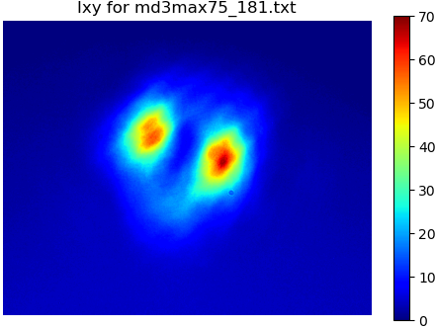
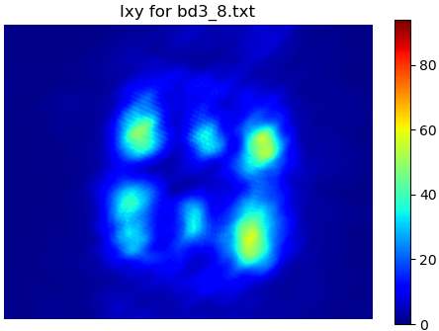
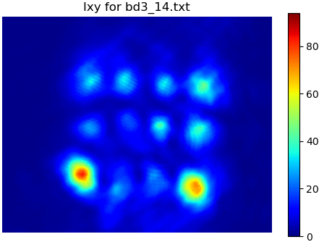
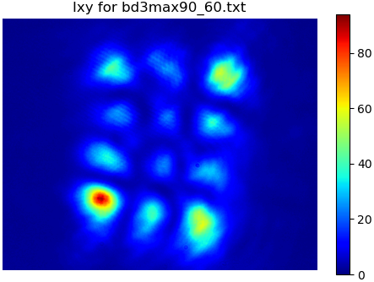
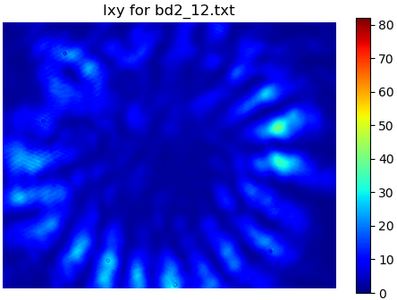
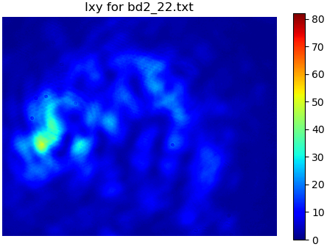
Mode Configurations
The spatial RWs formation was investigated for different transverse mode configurations:
Single-mode regime: The laser exhibits only a fundamental transverse mode.
Few-mode regime: The lasing is at one of low-order transverse modes (each Q-switch pulse corresponds to a certain mode with negligible partition of the other modes).
Multi-mode regime 1: The conditions for lasing are fulfilled for a number of higher-order transverse modes, but each Q-switch pulse corresponds to a combination of only 1-2 certain modes.
Multi-mode regime 2: The conditions for lasing are fulfilled for a number of higher-order transverse modes, the output beam patterns are complex showing the contribution of several modes.

Slide 5
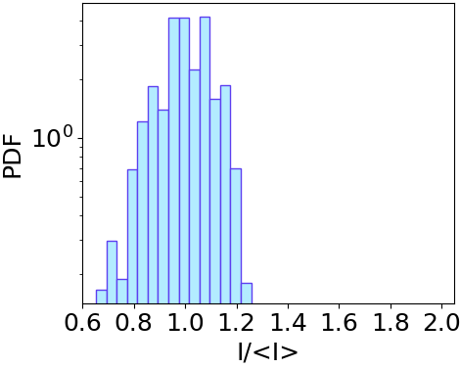
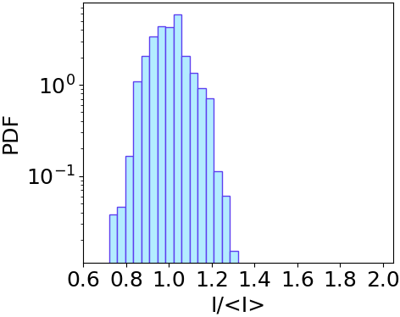
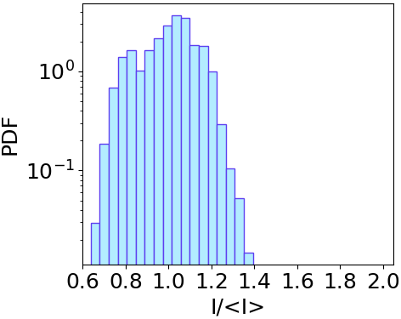
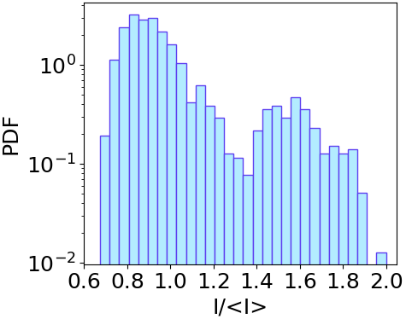
Peak Intensity Statistics of Spatial RWs
a) Single-mode regime
b) Few-mode regime
c) Multi-mode regime 1
d) Multi-mode regime 2
RW
The obtained pulse-to-pulse peak intensity statistics and examples of the transverse intensity distributions for a)-d) configurations.

Slide 6
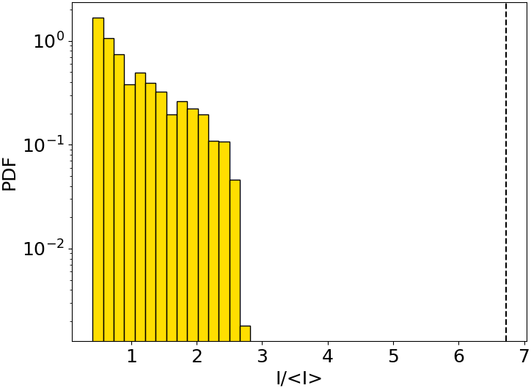
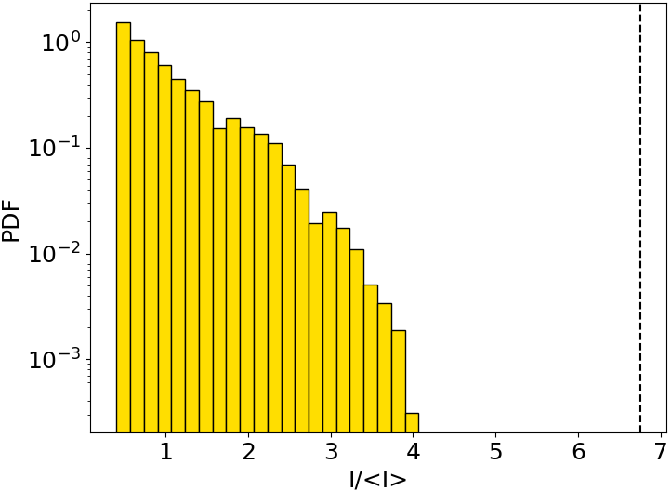
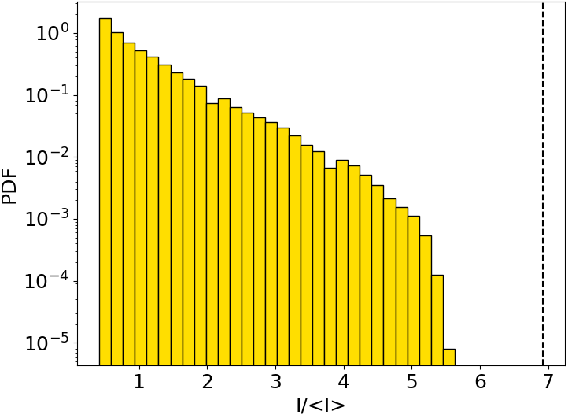
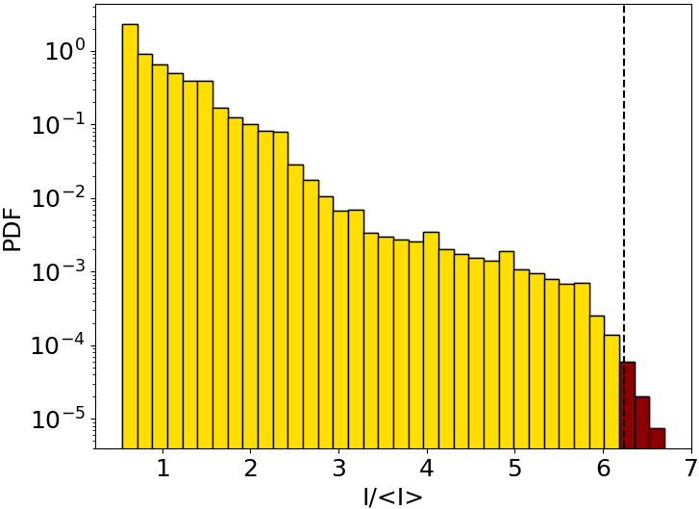
2D Intensity Statistics of Spatial RWs
a) Single-mode regime
b) Few-mode regime
c) Multi-mode regime 1
d) Multi-mode regime 2
2D intensity statistics calculated over a number of transverse beam profiles for a)-d) mode configurations. Black vertical lines indicate RW limits equal to four times the significant wave height values.

Slide 7
Conclusions
Obtained experimentally the generation of spatial RWs in the passively Q-switched Nd:YAG laser.
Investigated the probability of the spatial rogue waves formation for different laser mode configurations.
Demonstrated that the spatial RWs emerge only in the case of complex laser beam profiles, formed by a large number of transverse modes nonlinearly interacting in the cavity.

